Slide 1

Welcome to Kings Furlong Infant School & Nursery
2025
Mrs Lauren Herring
Headteacher

Slide 2
Here tonight…
Year R Class Teachers:
  Miss Lucy Irving– EYFS Lead & Year R Teacher
  Miss Micah Bremner–Year R Teacher
  Mrs Caroline Webb– Deputy Head Teacher / Inclusion SEND
  Miss Rachel McOmish – KS1 Lead and Attendance Champion
  Mrs Sarah Shepherd – School Business Manager
  Mrs Jacqueline Thorne – Admin Assistant

Slide 3
What will you find out today?
Understanding of the induction activities.
The answers to your questions around uniform, things your child will need and when they will need them.
The confidence that you and your child will be ready for school in September.

Slide 4
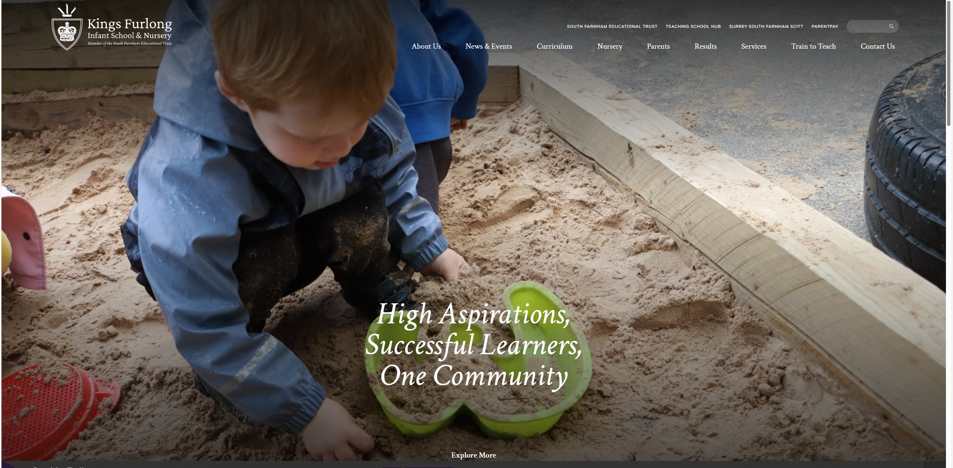
How will I find out what I need to know before September…?
Our communication with you will be via email and the MCAS app; the fact that you are here means that you will have received my letter via e-mail with an invite to today!
The website has lots of useful information for parents

Slide 5
Wraparound Care and Clubs
Explorers, our wraparound care club runs for the following times:
Breakfast - 7:45 – 8:45am (£5 per day)
After School - 3:15 – 4:30pm (£7 per day)
- 3:15 – 5:30pm (£10 per day)
Booked and paid through the MCAS App
explorers.kfis@sfet.org.uk

Slide 6
What we need to know from you…
Complete information on the My Child at School App, please see Sarah or Jacqueline if you need support with this tonight.
We need this information by Friday 20th June 2025

Slide 7
How will I find out what I need to know post September…?
You will have received via email a link to download and login to the My Child at School app so that you will receive updates and information from us.
Letters will also be uploaded to the website and if you receive a communication to say a letter has been sent but you haven’t received it you will be able to read it on the website.
Tapesty

Slide 8
How can you help your child be ‘school ready’
We would like the children to be able to…
Use the toilet
Wash and dry hands
Put on shoes - Velcro
Put on coats
Dress and undress for PE
Eat school dinners – using a knife and fork
Packed lunch – undo lunch bag/box

Slide 9
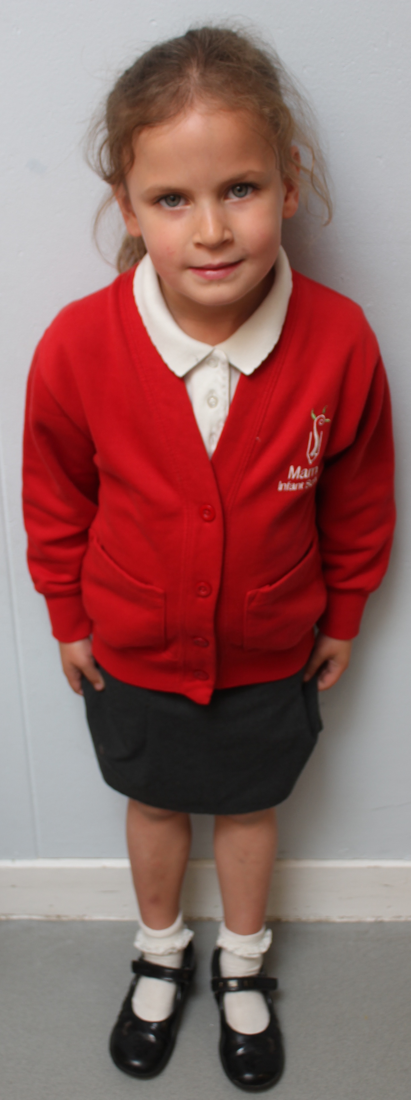
Uniform
Royal blue cardigan or sweatshirt (school logo)
White polo shirt
Grey trousers, shorts, skirt or pinafore dress
Grey or white socks, grey or blue tights
Black school shoes - trainers/boots/Crocs are not permitted, open-toed sandals are not permitted for health and safety reasons.
This can all be ordered through SkoolKit:
www.skoolkit.co.uk
Wellies to leave in school for outdoor play/mud kitchen!

Slide 10
PE Kit
Plain black/dark blue shorts, plain white T-shirt
Plain black/dark blue tracksuit during winter months
Trainers
Please provide this in a small drawstring bag. This needs to come in on a Monday and go home each Friday for washing over the weekend.
Notes:
PE bag
No back packs
Named

Slide 11
Forest School Kit
All children do Forest School activities once a week, this will start after October half term for YR.
The children will need long sleeved tops and full length trousers throughout the year. In the winter or when it is wet! They will need welly boots and a waterproof coat…or an all in one.
Notes:
PE bag
No back packs
Named

Slide 12
Please help us by…
Naming all items of clothing !
No back packs please
No toys

Slide 13
Homework
Phonics
Words
Numbers
Reading
Spelling – when your child is ready within Year R
Curriculum Information Evenings

Slide 14
School Rules
4 Simple Rules –
  We are kind.
  We listen.
  We look after our school.
  We always try our best.

Slide 15
Rewards
Kings Value Certificates and Badge
Stickers
Celebration assembly

Slide 16
Rewards and Sanctions
We believe that all children want to be good!
Sanction system:
  Warning – Turn their behaviour around
  Timer = 5 minutes off the next free choice session
  Continue = time out in another classroom
  Persistent issues = meeting with parents

Slide 17
Progress
Teacher/parent after school – ‘open door policy’
Learning Events
Parents’ evenings – 3 times a year
End of year reports

Slide 18


Others…
THRIVE
My Happy Mind

Slide 19
Which class?
Talk to pre-schools
Use taster sessions
Boys, girls, ages
When will you know?
Friday 27th June – 10-11am (parents attend with child)
Meet the teachers

Slide 20
Taster Sessions

Slide 21
Taster Sessions
Familiarisation with the classrooms and playgrounds
20th June Summer Fayre – 3:15pm – 5pm
25th June – Open evening 3.30 – 5.30pm
27th June - Reception open morning 10 – 11am – parents must attend.
17th July – Storytime with their new class/ class teacher 10am – 10.30am (no parents please)

Slide 22
First Days

Slide 23
First Days
2nd and 3rd September - INSET days
Thursday 4th September – Stay and Play (parents welcome to stay)
morning (A-H) or afternoon (I-Z)
Friday 5th September – Stay and play (without parents)
10 – 1pm this will include lunch
Monday 8th September – stay 'all' day 9:15 – 2pm
Tuesday 9th September – Full time 8:45 – 3:15pm

Slide 24
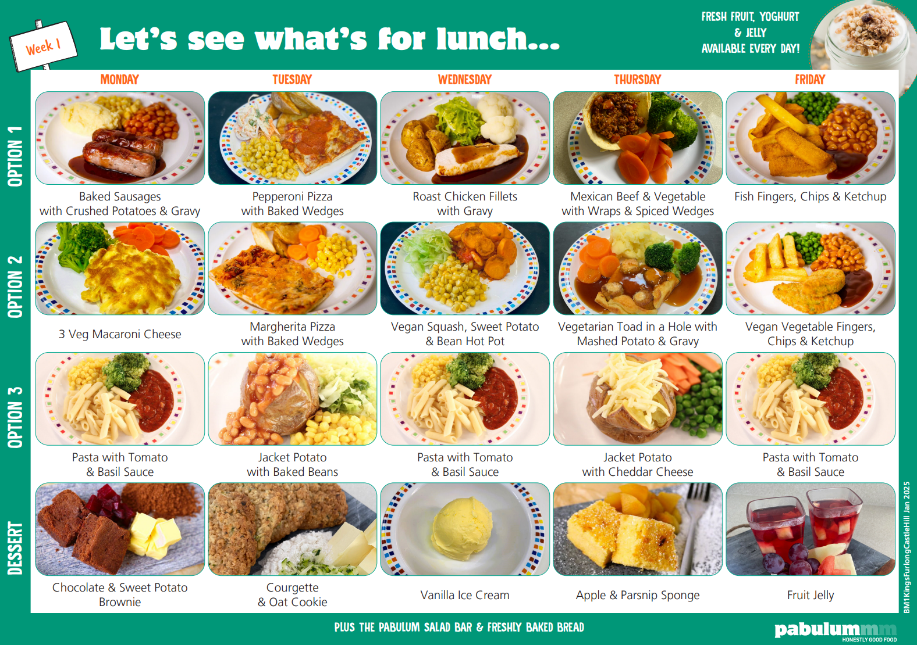
Lunchtimes
School dinners!
Menu
Packed lunches
Zones on the playground

Slide 25
Morning Snacks
Milk
Fruit

Slide 26
And now for the legal bits . . .
Attendance
Illness and notifying school
Leave of Absence in Term Time – vital you ask before you book. INSET days are added to holidays.
Medicines in school
Special medical or dietary requirements
Head lice
What to do if someone different is collecting your child at the end of the school day.
General support

Slide 27
And finally . . .
We’ll see you soon…
Please download the MCAS app or speak to Sarah or Jacqueline for support with this ☺
Any questions or things you would like to share the staff please come and talk to us!
Thank you!

